Slide 1
Appeal: Refusal to carry out an EHC Needs Assessment (EHCNA)

Slide 2
What is an EHCNA?
It is an assessment of a child or young person’s education, health and care needs
First step towards getting an Education Health Care Plan (Education Health Care Plan) which provides additional support and funding for a child or young person with special educational needs
SEND Code of Practice Section 9.1
Notes:
An Education Health Care Needs Assessment is the first step towards getting an EHCP which provides additional funding and support for a child or YP with SEN.
When the Local Authority agrees to carry out an EHCNA, this does not mean that your child or YP will definitely get an EHCP. Once the assessments are completed, the LA will decide whether or not to issue a Plan.
If you want more information on how to apply for an EHCNA please see the resources available on the IASS website.

Slide 3
The Legal Test
The legal test the LA must apply when receiving a request to assess is found in section 36(8) of the Children and Families Act 2014:
The local authority must secure an EHC needs assessment for the child or young person if:
(a) the child or young person has or may have special educational needs, and
(b) it may be necessary for special educational provision to be made for the child or young person in accordance with an EHC plan.
Notes:
after having regard to any views expressed and evidence submitted…, the authority is of the opinion that-
This is the only test that the LA should apply, and LAs who impose stricter criteria would be
acting unlawfully.

Slide 4
What happens when the assessment is not agreed?
The LA SEN Panel may decide that the education setting can support the child or young person’s special educational needs without the need for an assessment.
When this happens the SEN team writes to the education setting and the parent or young person to say that the request for an assessment has not been agreed
You may be offered a Next Steps meeting by the LA which is when the school, LA and parent meet to discuss how your child’s needs can be met by the school under SEN Support. You do not need to agree to this meeting but it may be helpful for you to understand the LA decision. This meeting is not a legal requirement, but the LA usually offers one when they make a refusal to assess decision.
You have the legal right to appeal this decision to the SEND Tribunal
Notes:
The LA has to formally notify you within 6 weeks of receiving the request whether or not they have agreed to carry out an EHC needs assessment.
If you receive a Refusal to Assess decision letter, you may also be offered a Next Steps meeting with the LA which the nursery/school/college should also attend. The purpose of this meeting is for the LA to discuss with you and the education setting their reasons for refusing to assess, and so that you can all discuss the best way for your child to be supported on SEN Support, in other words how your child can be supported by the resources and funding already available to the education setting.
If you agree to have a Next Steps meeting, this does not affect your right to formerly appeal the LA decision and we will cover the appeals process in more detail shortly.

Slide 5
Why might the LA refuse to carry out EHCNA?
Paragraph 9.14 of the SEND Code of Practice says that the local authority should consider:
“whether there is evidence that despite the early years provider, school or post-16 institution having taken relevant and purposeful action to identify, assess and meet the special educational needs of the child or young person, the child or young person has not made expected progress. “
The reasons for refusing to carry out EHCNA may be because the SEN Panel believe:
The information sent with the Request for Assessment shows that the needs are not severe or complex enough to require support via EHCP.
The school should be able to provide extra support within the school’s budget
There was not enough information or evidence from professionals and nursery/ school/college for the SEN Panel to be able to make a decision
Notes:
The main evidence the LA will consider is whether despite the education setting having put additional support in place, the child or young person has not made expected progress.

Slide 6
How do I challenge the LA decision?
The LA will write to inform you of their Refusal to Assess decision.
The letter will explain
what to do if you disagree with the decision.
notifies you of your legal right of appeal to the SEND Tribunal
you need to send this letter LA to the Tribunal when you register your appeal.
The date on the letter is the date your deadline for registering your appeal starts from.
You now have the right to appeal to the Special Educational Needs and Disability (SEND) Tribunal.
As part of the appeals process, you also have the right to request a Mediation meeting with the LA. This is a way to try and resolve disagreements before appealing to the Tribunal. Information about Mediation will be included in the Refusal to Assess decision letter you receive from the LA.
The letter also mentions about your right to seek impartial advice from IAS Service and how to contact them.
Notes:
You will receive formal notification from the local authority that they have refused the request to carry out an EHC needs assessment. This is a letter that will probably be emailed to you. This letter will explain what to do next if you disagree with the LA. you will be granted the right to appeal to the Special Educational Needs & Disability Tribunal.
This letter is important because if you decide to go ahead and appeal, you will need to submit the letter to the Tribunal as part of your appeal to prove that you have a legitimate right of appeal.
Your appeal deadline is also

Slide 7
Mediation
You will need to contact the Mediation Service– the LA decision letter will tell you how to do this.
Mediation Service will explain how mediation works and you can decide whether or not to agree to a mediation meeting.
This is a way of trying to resolve your disagreement with the LA without needing to appeal.
Whether you have a meeting or not, the Mediation Service will issue you with a certificate which you need to submit with your appeal registration.
Your deadline for appealing is 60 days from the date on the LA decision letter OR 30 days from the date on the mediation certificate whichever is the later
Notes:
If the LA decides not to conduct an assessment, it must give the reasons for its decision and notify you of your right to appeal this decision to the SEND Tribunal, together with information about time limits and the requirement to consider mediation. You will have to make contact with the Mediation Service who will explain how mediation works and will offer you the choice of accepting a Mediation meeting with the LA. If you decide to agree to a mediation meeting, this will be arranged by the mediation service. You will still have the right to appeal if mediation does not result in the LA agreeing to the assessment. After mediation, or if you choose not to accept a mediation meeting, you will be issued with a mediation certificate which you must send to Tribunal when you register your appeal.
PLEASE NOTE the time limits for appealing: you must send your appeal form to the Tribunal within two months from the date of the LA’s decision letter, or one month from obtaining a mediation certificate, whichever is later.

Slide 8
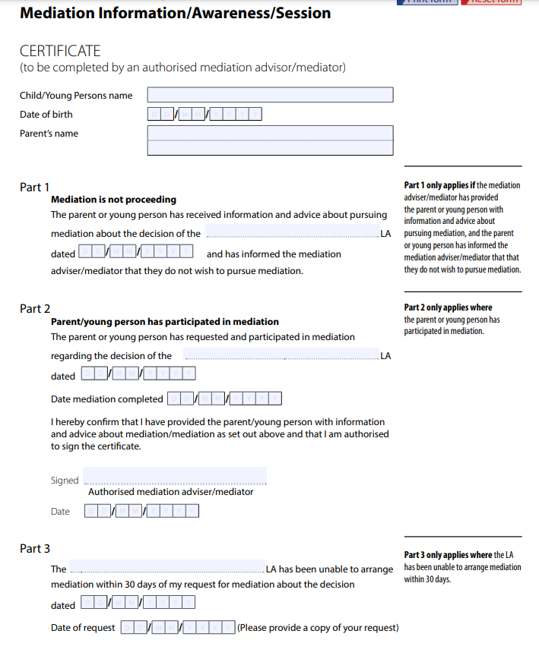

Slide 9
If you decide to appeal
You will need to show the SEND Tribunal evidence that
the child or young person has or may have SEN, and
may need special educational provision through an EHC
You can do this by showing that:
a full assessment is the only way to find out what the special educational needs are and what help is needed
the school/institution can’t provide all the extra support needed and that the support needed goes beyond a level that a mainstream school can be expected to provide
the school/institution has provided all the help that could be expected but the child or young person is not making progress.
Notes:
Going back to the legal test, you will need to convince the SEND Tribunal that the child
or young person has or may have SEN, and may need provision through an EHC plan
You can argue that:
1. a full assessment is the only way to find out what your child’s special educational needs are and what
help is needed;
2. the school/institution may not be able to supply all the educational help needed
unless it receives extra help from the LA;
3. the school/institution has provided all the help that could be expected but the
child or young person has not made enough progress.
You do not need to prove that an EHCP is necessary, only that it MAY be necessary.

Slide 10
SEND 35a Refusal to Assess form
The form you need for when the Local Authority has refused to secure (undertake) an EHC assessment of your child or young person following a request by the parents or the school is SEND 35A form.
You can download the SEND 35A form from the www.gov.uk website. Full address is here:
https://www.gov.uk/government/publications/form-send35a-special-educational-needs-and-disability-tribunal-appeal-a-refusal-to-secure-an-ehc-needs-assessment
Form has 11 Sections to complete
Notes:
The link above will take you to the SEND 35a form for Refusal To Assess Appeals. You will need to complete this form, and email it to the Tribunal attaching your LA decision letter, your mediation certificate and all your evidence.
Refusal to Assess appeals are paper based hearings and are decided on the written evidence that you submit, so it is important that you complete the form and provide as much detail as you can.

Slide 11
Notes:
This is the first page of the form. Please complete section 1 with your child/YP details.

Slide 12
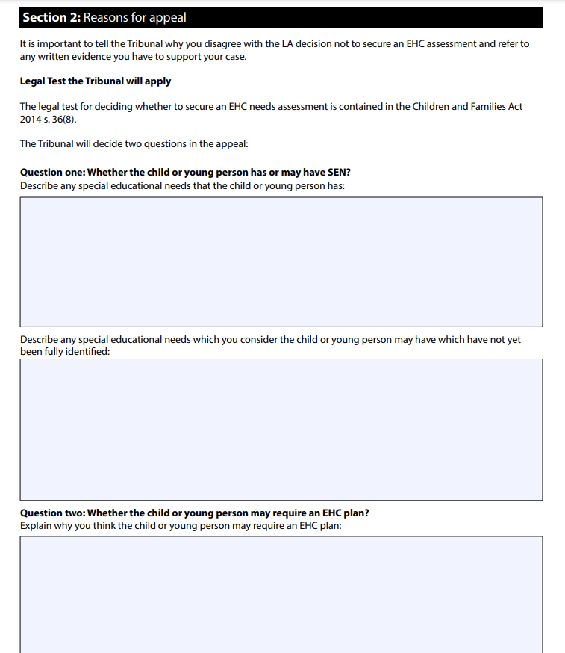
Section 2 of the SEND 35a appeal form asks
Question 1: Whether the child or young person has or may have SEN?
• Describe any special educational needs that the child or young person has
• Describe any special educational needs which you consider the child or young person may have which have not yet been fully identified
Question 2: Whether the child or young person may require an EHC plan? Explain why you think the child or young person may require an EHC plan.
You can type your answers on separate sheets of paper and attach them to the form. Make sure you write on the form “please see attached sheet for response for Question 1/Question 2” etc as appropriate
Notes:
Section 1 of the form asks for your personal information – name, address, name of child etc.
Moving to Section 2, there are 2 main questions on the SEND 35a form where you need to show evidence that the legal test for assessment has been met
You do not need to type your answers in to the boxes on the form. You can use separate sheets of paper and attach them to the form, but make sure you type in to the relevant boxes “see attached sheet for response to Q1/Q2”
Going back to the legal test, you will need to convince the SEND Tribunal that the child
or young person has or may have SEN, and may need provision through an EHC plan
You can argue that:
1. a full assessment is the only way to find out what your child’s special educational needs are and what
help is needed;
2. the school/institution may not be able to supply all the educational help needed
unless it receives extra help from the LA;
3. the school/institution has provided all the help that could be expected but the
child or young person has not made enough progress.
You do not need to prove that an EHCP is necessary, only that it MAY be necessary.

Slide 13
Section 2: Question 1- Whether the child or young person has or may have SEN?
Explain why you think the child/YP has, or may have, special educational needs, and back this up with evidence.
Look at the evidence the LA used to make its decision. This may include evidence from the early years provider, school or post-16 institution e.g.
school/college reports
Check the school SEN information report on the school website to see what they say they can provide under SEN Support for evidence that child/YP has needs that they cannot meet under existing resource
the records of any assessments carried out
what the educational setting did as a result of the assessments and what difference that made
any advice from the educational psychologist or other professionals who may have been involved.
If the evidence supports the LA’s decision you will have to look elsewhere for evidence to back up your case
Any evidence to show the child/Young Person is not making enough progress or that their progress is uneven. You can get this from school reports, for example are they doing better in some subjects but struggle in others? Is their progress less than expected for their age and development stage?
Consider independent/private assessment /report
behaviour records may help to show that there are challenging behaviours which are getting worse over time/need support or evidence of part-time timetable
Evidence of difficulties in any of the 4 areas of need – cognitive; social emotional behavioural; sensory; speech language communication
Your own experiences and those of the child/YP – for example, what difficulties do you experience in the home?
Information from others involved with the child or YP e.g. social worker, youth worker etc
Notes:
Now we will talk through the evidence and information you should include in your response to these 2 questions.
Question 1 – whether the child Or YP has or may have SEN
Look at the evidence that was submitted with the Request including the evidence from the education setting.
Check the schools SEN information report for details of what they provide under SEN Support. This may help you to demonstrate that your child has needs that are not routinely provided for under SEN Support and can only be met by an EHCP.
Look at any assessment reports, and see what the education setting did as a result of the assessments and what difference it made. This may provide evidence that your child or YP has not made sufficient progress despite the setting putting extra support in place.
If the existing evidence supports the LAs decision you will need to provide additional evidence to support your case
For example – is your child making good progress at school or is there evidence to show that their progress is uneven or that the gap between them and their peers is widening

Slide 14
Section 2: Question 2- Whether the child or young person may require an EHCP?
an EHC plan is only required when a child or young person’s needs cannot be met by SEN Support.
You need to provide evidence to show why your child’s needs cannot be met by the school/college by SEN Support. Use these points to support your case, whichever applies to your child/YP
a full assessment is the only way to find out what your child’s difficulties are and what
help is needed – e.g. despite some support my child is constantly excluded for his challenging behaviour and I do not believe that school fully understand his needs or how to support him
Or eg my child is on a part-time timetable
the school may not be able to supply all the additional support needed
unless it receives extra help/funding from the LA – you can ask the SENCO at your child’s school for a copy of the provision map for your child’s support to show that the school have provided all they help they can with their SEN Support resources
the school has provided all the help that could be expected but the
child or young person has not made enough progress – provide evidence e.g. provision map and SEN support Plans to show that your child needs more support than a mainstream school / college could be reasonably expected to provide
Notes:
Question 2 – does the child or YP require an EHCP
To answer this question you need to provide evidence that your child’s needs cannot be met under SEN Support and that a full assessment is the only way to find out what your child’s difficulties are.
There are some examples on this slide of evidence you might be able to provide that despite the school or college putting support in place and involving external professionals such as EP, your child has not made sufficient progress.
For example - is your child still being excluded because of challenging behaviour?
Look at the provision map which is a record of all the additional support your child has received and the amount of funding the setting has used to provide that support. This may show that the school has provided everything it could reasonably be expected to provide under SEN Support and that an EHCP may be necessary

Slide 15
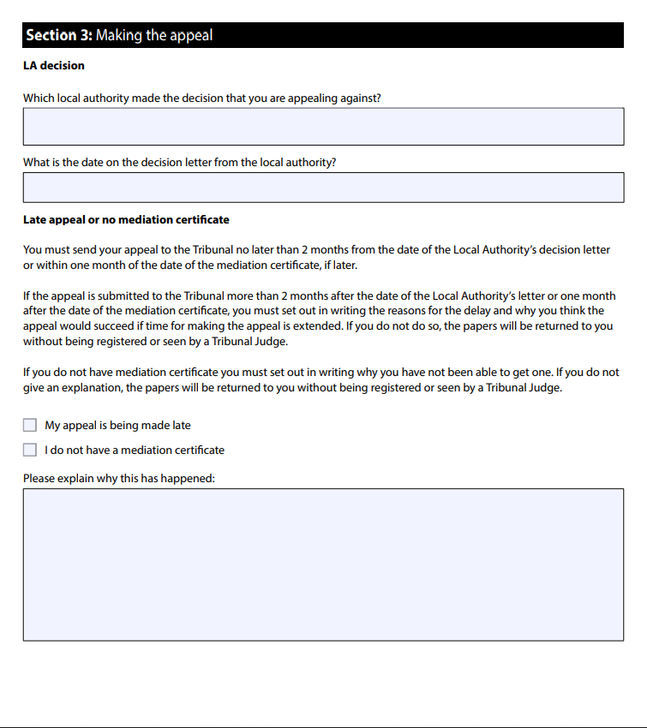
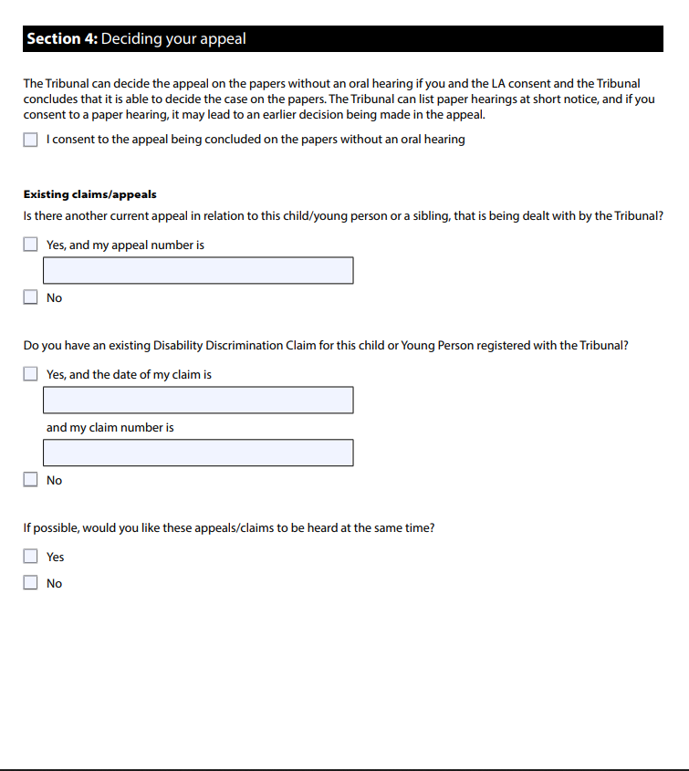
Notes:
Section 3 – it may be possible to get your appeal registered if you have missed the deadline or do not have a mediation certificate but you need to explain to the Tribunal why these things have happened and they will then decide whether to allow your appeal.
Section 4 – if you have very strong grounds for requesting an in person hearing you can request it in this part of the form. You also need to disclose any other outstanding appeals that you may have underway.
Section 4 on the SEND 35a states:
‘The Tribunal can decide the appeal on the papers without an oral hearing if you and the LA consent and the Tribunal concludes that it is able to decide the case on the papers. The Tribunal can list paper hearings at short notice, and if you consent to a paper hearing, it may lead to an earlier decision being made in the appeal’.
Therefore, you can tick ‘I consent to the appeal being concluded on the papers without an oral hearing’ to have the Judge look at all your evidence on papers only.

Slide 16
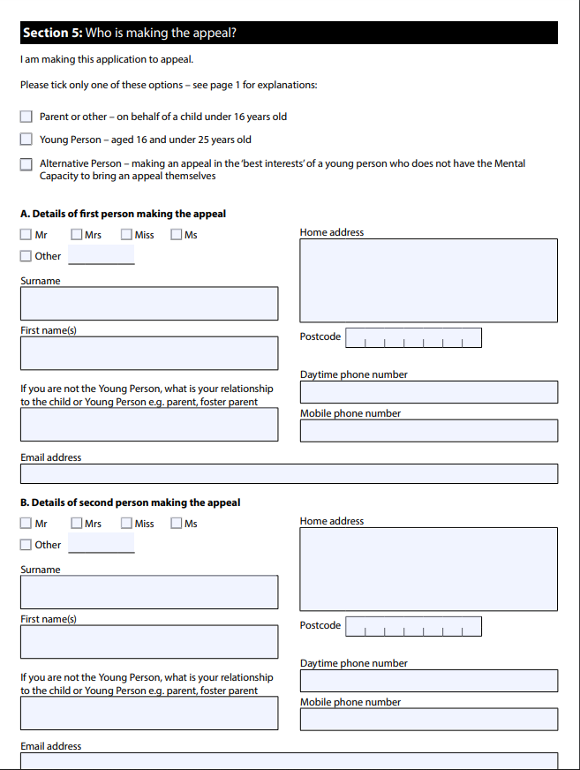
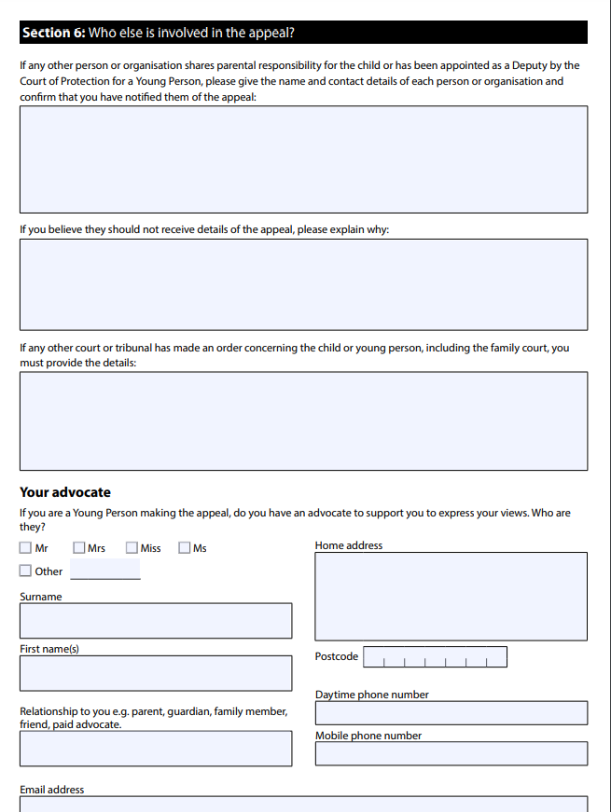
Notes:
Section 5 – this is about who is making the appeal. Usually this is completed by a parent or by both parents, or in the case of 16+ years the young person would complete this section.
Section 6 – is about any other parties involved in the appeal. For a Refusal to Assess appeal which is usually paper based, a YP would not need an advocate for the hearing because there isn’t one, so this section can be ignored. If the YP has requested an in person hearing and wants someone to attend with them they should fill this section out.
Legal Representative – most refusal to assess appeals are paper based therefore legal representation is not necessary. Leave this blank.

Slide 17
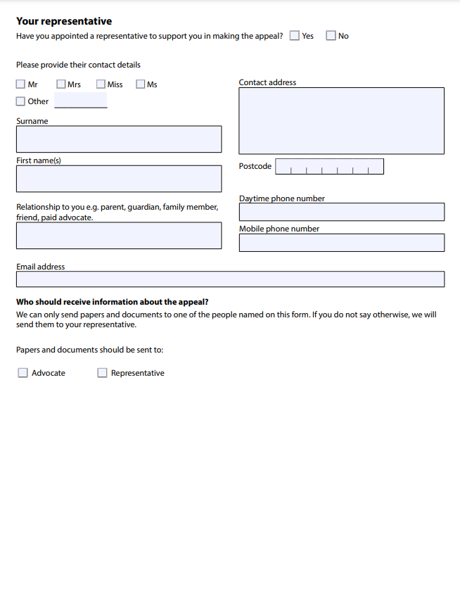
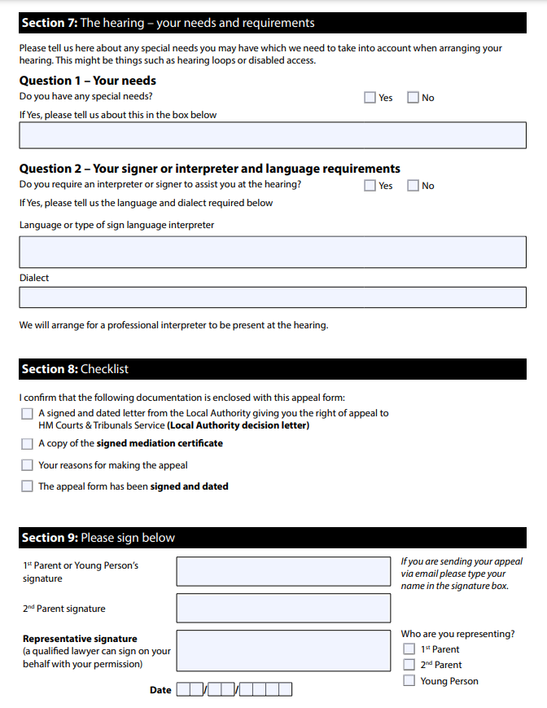
Notes:
For a paper based refusal to assess appeal, you are unlikely to have a legal representative, however if you have requested an in person hearing and wish to be represented by an SEN lawyer or a specialist SEN advocacy service you would put their details on the form here.
Section 7 – Q1 this is where you disclose any special needs that you have and in Q2 you can request signer or interpreter/language support, however for a paper based refusal to assess hearing you are unlikely to need this service.
Section 8 – please check the list in Section 8 and make sure you are sending along with the form the LA’s refusal to assess letter, your mediation certificate, your grounds of appeal which you may have typed up on separate sheets of paper, and the signed and dated appeal form.

Slide 18
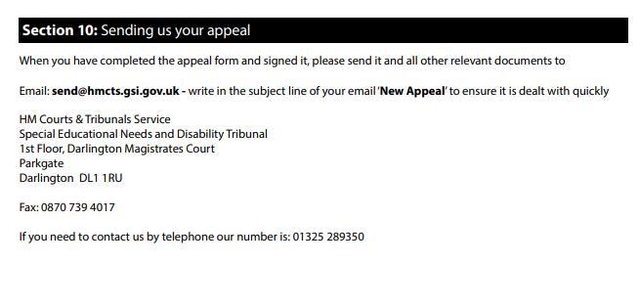
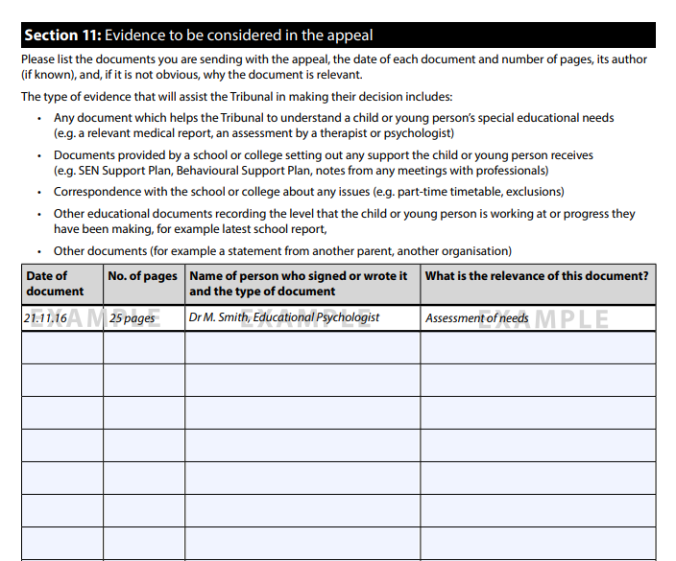
Notes:
Evidence and sending evidence
Email Size limit – you may need to send your evidence in more than one email if the email size is too large. Be sure to clearly mark your email in the subject heading with your child’s initials and birth date and « new appeal registration « and number the emails in order.
Documents must be unsecured and not password protected

Slide 19
The Appeals process
Refusal to assess appeals are usually ‘paper hearings’ and you will not be required to attend an oral hearing.
The Tribunal will confirm that your appeal has been registered and if paper based, they will give you an indication of when the hearing will occur (usually between two dates). For an in-person hearing you will be notified of the date and time of the hearing. Please allow up to 20 working days for a response.
The LA will be asked to respond to your grounds of appeal explaining why they refused to assess ( 4-6 weeks after the appeal is registered). The deadline for this response will be included in your Tribunal letter and registration documents.
The Tribunal looks at the evidence put before it and decides whether the LA decision followed the law and the Code. It will also make a decision based on what is right for the child at the date of the hearing.
The Tribunal is governed by the law, both the Act and its associated regulations, and has to follow the interpretation of that law by higher courts in judgments about previous SEN disputes. It must also have regard to the Code and generally accepts the Code’s guidance in coming to its decisions.
After the hearing you will be informed of the Tribunal decision in writing.

Slide 20
Outcome of the appeal
If you win your appeal the LA will be ordered to carry out the EHC needs assessment.
The LA must start the assessment process within four weeks of receiving the Tribunal’s order and decision in writing.
Getting the assessment agreed does not mean your child will get an EHCP. The LA will decide at the end of the assessment process whether or not your child needs additional support through an EHCP and you will be notified of their decision whether or not to issue an EHCP at the end of the assessment process.
If you lose your appeal, you can make another request for assessment immediately but unless you have new evidence or can show that things have changed you are unlikely to get a different outcome
Keep records of the support your child receives, any difficulties they are having at school and the progress they are making, so that you have evidence if you decide to make a request for assessment at a later date.

Slide 21
CONTACT US
In partnership with
Call 020 7641 5355
Deaf users 07816 216154
WhatsApp 0797 102 6703
Email iass@westminster.gov.uk
Visit westminsteriass.co.uk
You can find us at: First floor
215 Lisson Grove NW8 8LF
We can meet children and young people directly and talk to them about their options.
They can send a text or WhatsApp us on 0797 102 6703

