Slide 1
Transition from Secondary School to POST 16
Westminster Information Advice and Support Service (IASS)
Notes:
Welcome to our information session on the transition or the move from secondary school to post 16

Slide 2
Westminster Information, Advice and Support Service (IASS)
Westminster Information Advice Support Service (IASS) offer an impartial and confidential service to parents and carers with children aged 0-25 with special educational needs and disability (SEND)
Notes:
WIASS is a free service for all parents and carers in Westminster who have children with SEND, and for young people aged up to 25 years to get free, impartial and confidential support.

Slide 3
Today we will be…
Discussing the transition from Secondary School to post-16 setting/providers
Talking about ways to plan and prepare for a new setting
Looking at steps to employment
Notes:
Today’s session is for parents of children with special educational needs who are currently in Year 10 or 11.
We’re going to talk about the process for moving to post-16 education or training and the type of opportunities and support on offer.
How to prepare and plan for this
And steps towards employment

Slide 4
What is ‘Post-16’?
Education beyond the age of 16
A 16 year old can legally leave school at the end of the school year in which they turn 16 (normally the end of year 11). However, all young people must be in some kind of education or training until the age of 18.
Options:
Further education – college or sixth form
Work-based training
Supported employment
Employment
There is a 16+ Pathways Planner and other helpful information about transition on the Local Offer that may help. Google: Westminster SEND Local Offer PFA page
Notes:
If not, classed as NEET: Not in education or training (NEET) 16-18yrs. There is NEET support for those who fall into this category.
Various options after leaving Secondary school – college, or work-based training.
PFA – preparing for adulthood

Slide 5
Young people with Education Health Care (EHC) Plans
Discussions about ’Preparing for Adulthood’ should begin from Year 9
EHC plans must be reviewed and amended in plenty of time before the move to Post-16 Education.
For post-16 transitions, any changes following an annual review should be finalised, including naming a setting by 31st March.
Notes:
Discussions about ’Preparing for Adulthood’ should begin from Year 9 at their annual review meetings (arranged by the school).
Usually following year 10 admission (form by end of year 10 about placement/where to go after year 11). If the young person wants to attend a different school (for sixth form) or a college, then the current school should help to shape the EHC plan through an annual review and discussions with the Local Authority, they should also help to set the new outcomes for the young person - “Earlier the better to secure first choice”
31st March – legal date
Those without EHCP will follow normal admissions process around Dec/Jan start making plans/choices along with support. Transition support can be provided by the school so they should be contacted in the first instance.

Slide 6
Year 11-12 Transition Timeline (for students with an EHCP)
Stage | When | What
1 | Year 10, Summer Term | During the Annual Review you discuss next steps after year 11 and the type of education provision which would best meet your child’s needs
2 | Year 10, Summer Term | Visit colleges, sixth forms and specialist settings
3 | Year 10, June | Provide 2 preferences to the LA SEN Service
4 | Year 10, 30th July | Last date to send LA preferences for year 12
5 | Year 11, November - December | LA SEN Service consult with preferences and nearest appropriate education placement. If college is a preference, apply directly
6 | Year 11, December - January | A draft / proposed amended EHCP sent to you including name of allocated year 12 setting. Reconfirm your preferences
7 | Year 11, 31st March | EHCP finalised and issued naming year 12 setting for September
Notes:
Here is a timeline chich break downs how plans should be made from year 10 to support the process.

Slide 7
Choosing where to study for Post-16
Discuss your preferences with key people
Research related to your goals and your interests
Use the Local Offer website
Visit Post-16 setting at Open Days
Find out about the types of support the setting offers young people with SEN – check individual settings
Notes:
Key people: Speaking with parents, peers, career advisors, teachers, SENCO
Making an informed choice
Choosing more than one option
Having a back-up plan

Slide 8
Preparing for the Transition
Understand expected/predicted grades during year 11
Research and identify 2-3 options
Access careers advice in school
Speak to the SENCO at your school and ask for your student record
Contact the new Head of Additional Learning (mainstream) or the Head of Inclusive/Supported Learning and arrange a meeting to discuss support available and their transition policy
Resources/ helpful documents:
Ask for an example timetable or ‘day in the life’ of a student
Ask for photo’s of the setting / take a tour
Create a ‘personal profile’ or a ‘communication passport’ to share with key staff
Consider how you will travel to a new setting
Notes:
Post 16 options/entry requirements: e.g. sixth forms, Further Education colleges, specialist SEN provision
2-3 options which can provide the right support, environment and course to achieve future employment aspirations
Transition Policy – who the school, college etc will help prepare
Consider how you will travel to a new setting – year 10 annual review – outcome for travel training so by the end of year 11 this has been put in place in enough time (to support the transition).
You may be eligible for Travel Training or specific SEN Transport, contact traveltraining@rbkc.gov.uk or travelassistance@rbkc.gov.uk (this is a bi-borough service)
3 key points:
Ask questions
Get advice
Research

Slide 9
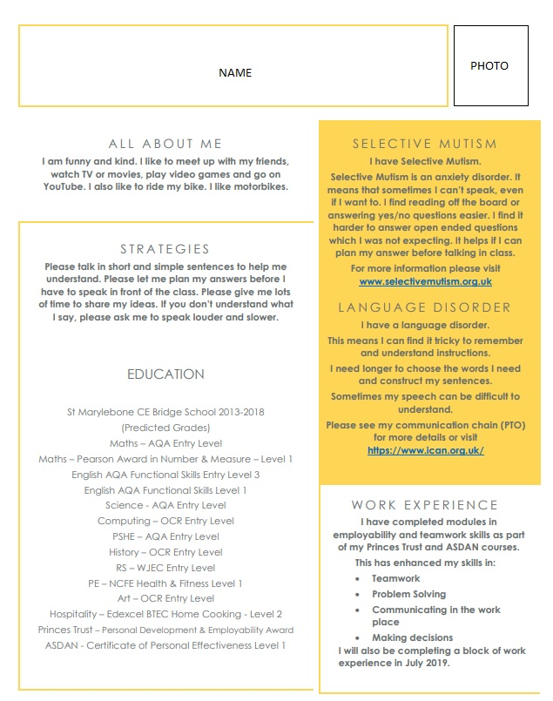
Personal profile / communication passport
A document to share with the people supporting you
Describing preferred communication methods
Gather information from people who know them
Describe needs positively
Notes:
Check what your secondary school has available in this regard and ask for it to be shared with you
Describe needs positively – likes/dislikes
What do people need to know about you?
Includes:
All about the YP
Strategies
Communication
Education and results
SEN
Other experiences
Photo

Slide 10
Results
Results day for GCSE students will be on Thursday 25th August 2022
Results day for A level students will be on Thursday 18th August 2022
If you don’t get the results you expected…
Speak to the college, school, or training provider you planned to go to. They may still take you, especially if you only just missed out on your grades.
Talk to your teachers and family about your options.
Speak to teachers and check with your chosen school or college about re-sitting exams.
Contact us for additional advice on our helpline 020 7641 5355
Notes:
Best to enrol on the course and secure a placement on the course, then figure out the other elements later in terms of EHCP, transport etc
Get support with Enrolment Day – who can help?
If you don’t want to re-sit your exams but want to go on to further education, most colleges and training providers will offer courses at a variety of levels. Contact them to find out what is available.

Slide 11
Placement offers
Conditional:
Show the conditions that you have to meet before you will get a place.
Unconditional:
These mean you've already met the entry requirements, so the place is yours if you want it!
Unsuccessful or withdrawn choices:
A withdrawn application means a course choice has been withdrawn by either you or the college.
An unsuccessful application means they've decided not to offer you a place on the course.
Notes:
Conditional: For most people, this means waiting for results day in summer to see if your exam results meet the conditions. They could be a combination of grades, scores or subjects.
Unconditional: But:
Check the offer carefully to see if there’s anything else you need to do and if it’s not clear, contact the uni or college.
Remember, by accepting an unconditional offer, you are committing to go to that uni or college, so you can't make an insurance choice.
If you change your mind, you can decline your place and apply using Clearing.
If you're taking exams but have been made an unconditional offer, your results won't affect whether or not you get accepted. But, although your place won't be dependent on your grades, taking your exams is really important to prepare you for uni or college and could impact your future employment.
Unsuccessful or withdrawn
A withdrawn application means a course choice has been withdrawn by either you or the university/college - The reason will show up in on your application – maybe you didn't respond to emails/letters they sent, or missed an interview.
An unsuccessful application means they've decided not to offer you a place on the course.
Sometimes they'll give a reason, either with their decision or at a later date. If not, you can contact them to ask if they'll discuss the reason with you.
Clearing is how unis and colleges fill any places they still have on their courses. From 5 July – 19 October, you can apply for a course using Clearing if you're not already holding an offer from a university or college, and the course still has places. You can use Clearing if: you're applying after 30 June

Slide 12
What does the law say?
SEND Code of Practice (2015):
Section 7.5 says
Colleges should be ambitious for young people with SEN, whatever their needs and whatever their level of study.
They should focus on supporting young people so they can progress and reach positive destinations in adult life.
These destinations include:
higher education
further training or employment
independent living
good health
participating in the community
8.22 Information about previous SEN provision and what has worked well should be shared with the college/6th form
Notes:
The SEND Code of Practice is statutory guidance for organisations that work with and support children and young people with special educational needs and disabilities. It is a set of guidelines that the Department for education say local authorities and schools should follow.
Details of legal requirements that must be followed without exception. Statutory guidance that must be followed by law

Slide 13
Some things might look different at College
You may be travelling to different campus locations
Start and finish times will be different
College timetables are different e.g. free periods, study time
Things will feel less-structured that school
You should discuss this at your annual review, with your EHC Coordinator and with the school/college staff to agree on what is in your/the young person’s best interests.
Notes:
Consider the differences from Secondary School to College
6th forms are similar to Secondary school
Colleges are different and you many not have to attend all day - timetable – different days, afternoon/morning, many college courses are delivered over three or four days a week – although it does depend on the course
Where young people have EHC plans, local authorities should consider the need to provide a full package of provision and support across education, health and care that covers five days a week, where that is appropriate to meet the young person’s needs. A package of provision can include non-educational training activities such as: volunteering or community participation, work experience, opportunities that will equip young people with the skills they need to make a successful transition to adulthood.

Slide 14
Travelling to a setting
Some campuses are located on more than one location
Familiarise yourself with your journey through TfL, Google Maps or City Mapper
Look into 18+ Oyster photocard for discounted travel (for students) https://tfl.gov.uk/fares/free-and-discounted-travel/18-plus-student-oyster-photocard
You may be eligible for Travel Training or specific SEN Transport, contact traveltraining@rbkc.gov.uk or travelassistance@rbkc.gov.uk (this is a bi-borough service)
More information about Accessible Travel Options can be found on the Westminster Local Offer Accessible transport options | Westminster FIS
Notes:
Prepare to travel, learn the routes and practice

Slide 15
Vocational Programmes (BTECs)
Alternative to A-levels
BTECs are specialist work-related qualifications
Often studied at school / college
More practical learning
Skills to move to further study (University) or get a job
BTECs are designed for young people interested in a particular sector or industry but who are not yet sure what job they’d like to do
Ages 14-19years
You could study a BTEC at Level 2 or 3, either alongside other qualifications/ /programmes
You can also study a BTEC as a standalone course.
Subjects include: applied science, art and design, business, childcare, media, sport, travel and tourism and more
Notes:
BTEC stands for the Business and Technology Education Council.
A BTEC is a vocational qualification studied at school or college. They tend to be work-related and are ideal for any student who prefers more practical-based learning. BTEC qualifications allow you to continue further study at university or enter the workforce.
Level 2. A level 2 qualification is similar to having a GCSE at grade A*–C or 4-9.
There are over 2,000 BTEC qualifications across 16 sectors – they are available from entry level through to professional qualifications at level 7 (equivalent to postgraduate study).

Slide 16
Courses that combine work and study
National Graduate Development Programme (NGDP)
Supported Internship
Apprenticeship
Traineeship
Level 2 - 7
Level 1 / 2
Entry Level / Level 1

Slide 17
Supported internships (Entry level 1)
16 – 24 year olds with an EHCP
Working from entry 1 – Level 1 English and Maths
16 hours p/w on work placement
1:1 job coach support
1 day studying English, maths and employability qualifications
Aim to prepare for progression into paid work
Supported Internships usually start once a year in September.
Westminster and RBKC have programmes in the Local Authority, hotels, hospitality and more
More information on the Local offer Westminster City Council Supported Internship | Westminster FIS
Notes:
A level 1 qualification is similar to having a GCSE at grades D–G or 1-3.

Slide 18
Traineeships (Level 1/2)
16 – 24 year olds
Gives skills or experience to get an apprenticeship or job
Flexible education and training programme
Duration: six weeks and up to a maximum of six months,
Work experience placement tailored to your individual career needs
Real work experience and job skills
Opportunity to improve your English and maths (if needed).
Suitable for:
young people who have no qualifications above GCSE or equivalent
unemployed, or work fewer than 16 hours per week
little work experience
motivation to work
Notes:
prepares you for a future career by helping you to become ‘work ready’.

Slide 19
Local Traineeships: PSEV
PSEV Traineeships
Baseline Studios, North Kensington
16-24 year olds
Duration: up to 12 weeks
Work experience
Employability skills
Helps to move into further education or training
Industry examples:
Admin
Customer Service
Retail
More info https://psev.org/jobseekers/
Notes:
Example in the local area of an organisation providing local traineeships

Slide 20
Local Traineeships – Ixion
Construction Traineeships
London wide
16-24 year olds
Level 2 (16-18yrs)
Level 3 (19-24yrs)
Not in education employment or training (NEET)
6-12 week placements
Ongoing start dates
E: traineeships@ixionholdings.com
W: https://www.ixionholdings.com/traineeships-for-individuals/
Notes:
Example in the local area of an organisation providing local traineeships

Slide 21
Local Traineeships: WAES
Westminster Adult Education Service, Marylebone.
https://www.waes.ac.uk/category/apprenticeships/traineeships
Ages 19-24
Formal qualification in a vocational subject including technical skills development
An employability qualification
Soft skills development
English and maths qualifications (if required)
Gaining 70+ hours of high-quality work experience with a supportive employer
Examples of industry:
Childcare
Accounting
Graphic Design
Teaching Assistant
Business Administration
Customer Care
Notes:
Example in the local area of an organisation providing local traineeships

Slide 22
Apprenticeships (Level 2)
For 16-24 year olds
Combine training in a job with study.
Depending on the level, Apprenticeships take 1 to 5 years to complete.
Apprentices will:
- work alongside experienced staff
- gain job-specific skills
- earn a wage and get holiday pay
- get time for study related to their role (usually one day a week)
Level 2 – an English and maths qualification of at least level 1 (Functional Skills Level 1 or GCSE grade E or 2).
You must also study for a level 2 qualification in English and maths and take the tests, before taking the end-point assessment or achieving an apprenticeship framework

Slide 23
Employability programmes
For young people aged 16 or 18 years depending on the programme
Skills and support to get into employment or training
Programmes are tailored to individual needs
Some provide on-going support after a successful placement
Access to a job coach
Support can be 1:1 or in small groups and each programme varies in length
They can:
Make students aware of career options and employment routes
Help develop career goals
Support students to create an action plan with targets to achieve their goals

Slide 24
Supported Employment Services
Scope Accessible Careers Advice
disabled or have an impairment or condition
aged 15 to 25
make you aware of all the career options and the employment routes open to you
develop your career goals and create an action plan to help you achieve them
W: https://www.scope.org.uk/
Westminster
Westminster Employment* LD Supported Employment Service
1:1 person-centred support to identify skills and jobs suited
Transition support into work, job coach support.
Access to Work funding applications.
Westminster Employment Service (all residents aged 16+)
Website: https://www.westminster.gov.uk/
Kensington and Chelsea
Balance Supported Employment Service (age 18+)
1:1 person-centred support to identify skills and jobs suited
Transition support into work, job coach support
Access to Work funding application
Website: https://www.balancesupport.org.uk/
Notes:
Example in three organisations in the local area providing supported employment services

Slide 25
Further contact details:
Genius Within: https://www.geniuswithin.co.uk
Westminster Disability Employment sara.taukolonga@dwp.gov.uk
Making the Leap https://makingtheleap.org.uk/what-we-do/young-people
Mastering My Future, 2-3 degrees https://2-3degrees.com/school-programmes/mastering-your-future-programme/
Resurgo Spear North Kensington www.resurgo.org.uk/spear-programme/the-spear-programme/

Slide 26
Reasonable adjustments
Employers must make reasonable adjustments to make sure workers with disabilities, or physical or mental health conditions, are not substantially disadvantaged when doing their jobs.
They are dependent on individual needs
This applies to all workers, including trainees, apprentices, contract workers and business partners.
Get help and advice:
You can get advice on reasonable adjustments from the Disability Employment Adviser (DEA)
St Marylebone Job Centre Plus, 26-46 Lisson Grove, London, NW1 6TZ. Ph: 0207 853 4625
You can apply for Access to Work if you need extra help
Access to Work support depends on needs and includes practical support
Notes:
Reasonable adjustments – depend on induvial needs.
Reasonable adjustments include:
changing the recruitment process so a candidate can be considered for a job
doing things another way, such as allowing someone with social anxiety disorder to have their own desk instead of hot-desking
making physical changes to the workplace, like installing a ramp for a wheelchair user or an audio-visual fire alarm for a deaf person
letting a disabled person work somewhere else, such as on the ground floor for a wheelchair user
changing their equipment, for instance providing a special keyboard if they have arthritis
allowing employees who become disabled to make a phased return to work, including flexible hours or part-time working
offering employees training opportunities, recreation and refreshment facilities
Access to Work:
The support you get will depend on your needs. Through Access to Work, you can apply for:
a grant to help pay for practical support with your work
advice about managing your mental health at work
money to pay for communication support at job interviews
Including Practical support with your work
Access to Work could give you a grant to help pay for things like:
BSL interpreters, lip speakers or note takers
adaptations to your vehicle so you can get to work
taxi fares to work or a support worker if you cannot use public transport
a support worker or job coach to help you in your workplace

Slide 27
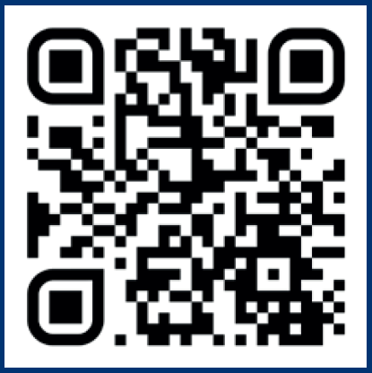
Further Support/Advice
Westminster Befriend a Family: Befriending/Mentoring for young people and families https://www.befriendafamily.co.uk
Westminster Mind: Building Employment, Skills and Training (BEST) https://www.bwwmind.org.uk/local-mind-services-london/community-mental-health-services/back-to-work-employment-service/
Caxton Youth Organisation: SEND Youth Club in Westminster https://caxtonyouth.org/
Post-16 options: National Careers Service https://nationalcareers.service.gov.uk/careers-advice/career-choices-at-16
Make it Happen: parent group for parents with children with SEND https://www.wppg.org.uk
Post-16 Pathway Planner https://fisd.westminster.gov.uk/kb5/westminster/fis/advice.page?id=LbMHW9q_lY4
Preparing for Adulthood https://www.preparingforadulthood.org.uk/
Council for Disabled Children https://councilfordisabledchildren.org.uk/resources-and-help/im-young-person
Prospects https://www.prospects.ac.uk/
Disability Student Allowance information for undergraduate/postgraduate students https://www.gov.uk/disabled-students-allowance-dsa
Westminster Local Offer http://localoffer.westminster.gov.uk (use QR code)

