Slide 1
How to make a request for an Education Health Care Needs Assessment (EHCNA)
Westminster Information Advice and Support Service (IASS)

Slide 2
Westminster Information, Advice and Support Service (IASS)
Westminster Information Advice Support Service (IASS) offer an impartial and confidential service to parents and carers with children aged 0-25 with special educational needs and disability (SEND)
Notes:
Welcome to our information session. WIASS is a free service for all parents and carers in Westminster who have children with SEND, and for young people 16+

Slide 3
What is an EHCNA?
Assessment of a child or young person’s education, health and care needs
First step towards getting an Education Health Care Plan which provides additional support and funding for a child or young person with special educational needs
SEND Code of Practice Section 9.1
Notes:
An Education, Health and Care (“EHC”) needs assessment is an assessment of a child or young person’s education, health and care needs. It is the first step to getting an Education, Health and Care plan (“EHC plan”).
An EHC plan brings your child’s education, health and social care needs into a single, legal document. Your child must have special educational needs to be eligible for a plan.
An EHC plan can result in additional support and funding for a child or young person with special educational needs (“SEN”).

Slide 4
Who can request an EHCNA?
SEND Code of Practice section 9.8
The following people have a specific right to ask a local authority to conduct an
education, health and care needs assessment for a child or young person aged
between 0 and 25:
• the child’s parent
• a young person over the age of 16 but under the age of 25, and
• a person acting on behalf of a school or post-16 institution (this should
ideally be with the knowledge and agreement of the parent or young person
where possible
Notes:
Schools can make a request for assessment but Parents also have the legal right to ask the local authority to conduct an assessment of their child’s education, health and care needs. Young people (aged 16+) can also make a request on behalf of themselves.

Slide 5
When should an EHCNA be requested?
EHCNA request should be considered when a child or young person has been receiving additional support at nursery, school or college (SEN Support) but is not making expected progress
Section 36 of the Children and Families Act 2014 states that the local authority must secure an EHC needs assessment for the child or young person if:
(a)the child or young person has or may have special educational needs, and
(b)it may be necessary for special educational provision to be made for the child or young person in accordance with an EHC plan.
SEND Code of Practice section 9.14
In considering whether an EHC needs assessment is necessary, the local authority should consider whether there is evidence that despite the early years provider, school or post-16 institution having taken relevant and purposeful action to identify, assess and meet the special educational needs of the child or young person, the child or young person has not made expected progress
Notes:
Your child’s school or other setting will often be able to meet the needs of children through SEN support but sometimes a child or young person needs a more intensive level of specialist help that cannot be met from the resources available to schools and other settings to provide SEN support. In these circumstances, you or your child’s school or other setting could consider asking your local authority for an Education, Health and Care (EHC) needs assessment for your child.
For your child to be considered as needing an EHCNA, there are 2 tests that must be met (read second paragraph)
You can ask your local authority for an EHC needs assessment if you think your child needs one. Anyone at your child’s school (such as your child’s teacher) can also ask for an assessment to be carried out. Others who work with your child can also tell the local authority if they think an assessment is needed (such as your doctor, health visitor or nursery worker).

Slide 6
How do I make a parental EHCNA request?
In writing, to the local authority
Using the Local Authority EHCNA request forms
Or Westminster IASS template letter
Explain why you believe
your child has or may have special educational needs, and
that they may need special educational provision to be made through an EHC Plan
The LA must reply within six weeks
Notes:
You can make a request for an EHC needs assessment in writing to the local authority.
There are two ways you can do this, either by downloading the LA request form from the local offer website,
Or using the Westminster IASS template letter which you can download from our website.
You will need to explain why you believe your child has or may have special educational needs, and why you believe that they may need special educational provision to be made through an EHC Plan.
When the LA has received your request, they must reply to you within six weeks to let you know if they have agreed to do the assessments.

Slide 7
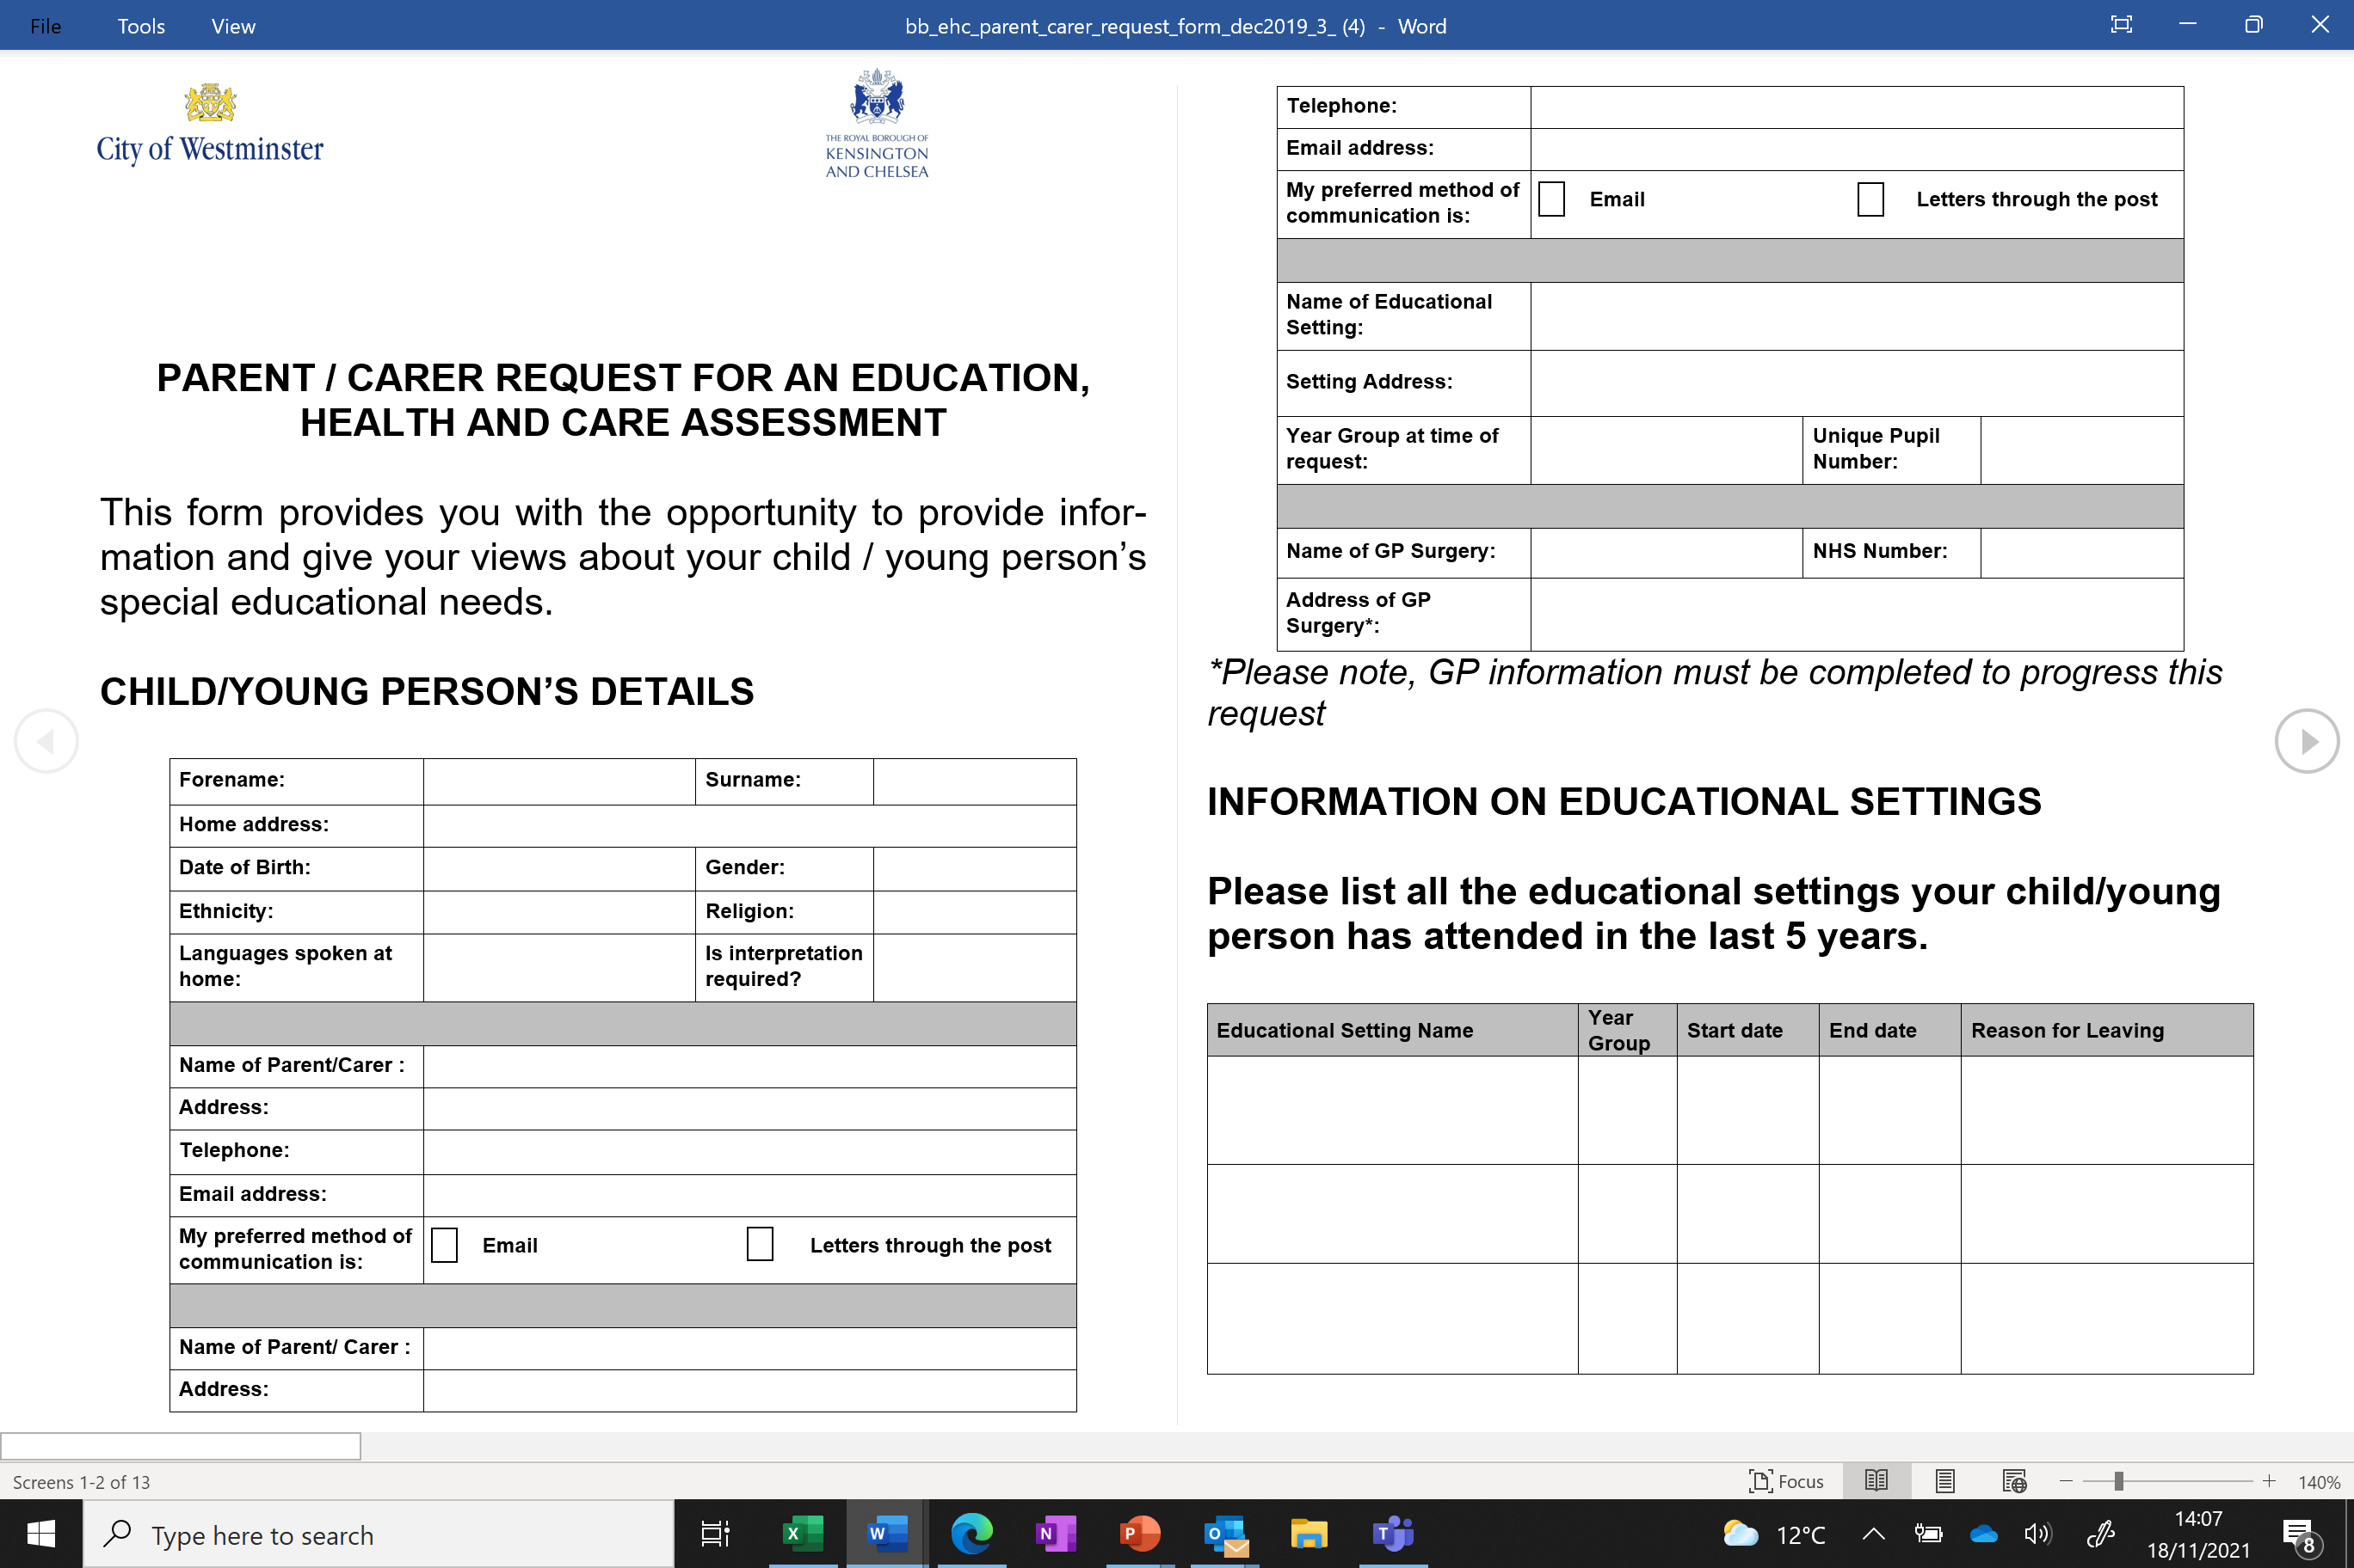
Local Authority parent/carer request form
You can download this from the Westminster Local Offer for SEND at
https://fisd.westminster.gov.uk/kb5/westminster/fis/advice.page?id=qSKh_qxMV6Y
Notes:
This is the local authority request form which you can download from Westminster local offer website. You can find it by googling Westminster local offer EHCNA request forms.

Slide 8
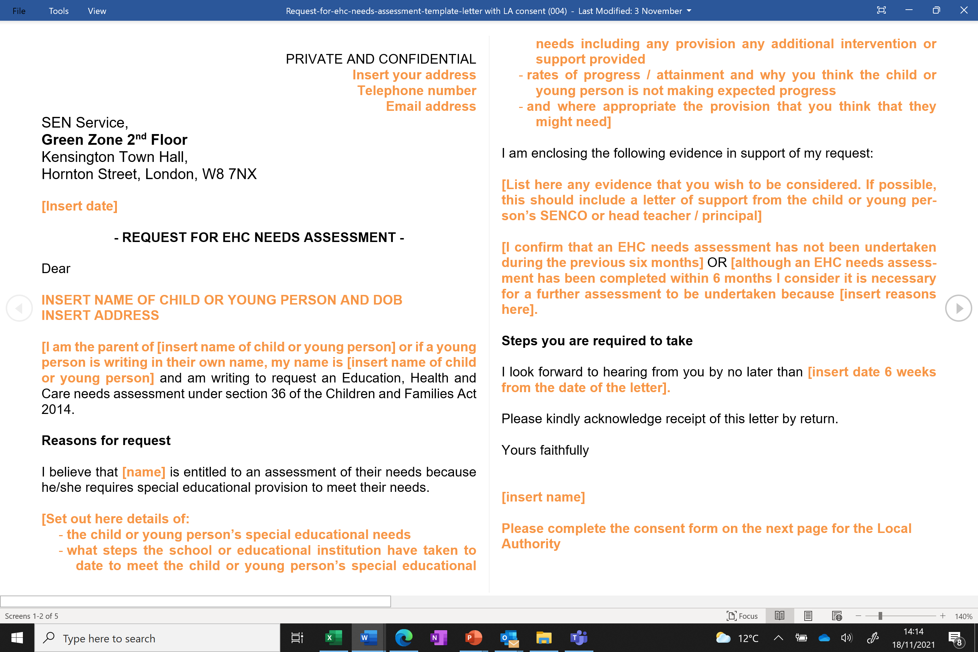
Westminster IASS parent/carer request letter
You could use the template letter which can be downloaded from our website
Notes:
If you prefer, you can download a template letter from the Westminster IASS website. You should also complete the additional information sheet and the consent form for the LA if you choose to use this template to make your request.

Slide 9
What information should I include?
A description of your child or young person’s special educational needs
What steps the school or educational institution have taken to meet your child’s special educational needs including any additional support, provision or interventions that the school have put in place
rates of progress / attainment
why you think your child or young person is not making expected progress
provision (support / therapies / interventions) that you think that they might need
Notes:
To submit an EHCNA request, you will need to include information about your child or young person’s special educational needs
You will need to find out what steps (read through next 2 points)…………you can obtain this information from the school Senco and teaching staff.

Slide 10
Include evidence of SEN
List the SEN already identified by school/college and attach any supporting evidence eg SEN Support Plans, school reports - and include any other needs that you think have not yet been identified by school/college
List the reasons why you feel your child has SEN and any evidence you have to support this eg school reports, evidence of exclusions, written evidence from any medical or other experts
Notes:
When considering a request for assessment, the LA need to apply a 2 part test which is set out in section 36 of the Children and Families act 2014. Part one of the test states that the child or young person has or may have special educational needs. So the first thing you need to do is provide information about your child’s SEN, and any evidence you have from the school or college and from any professionals who have worked with your child.
(Read through second point) as this may demonstrate that SEN Support is not enough to remove the barriers to your child’s learning, and that they may need an EHCP in order to access the curriculum.

Slide 11
Explain why you think an EHCP may be necessary
List any reasons you have to show why you think an EHCP may be needed
Provide evidence if you can that shows the school may not be able to provide this support from their own resources, for example:
individual support beyond that which a mainstream school can be reasonably expected to provide
therapies from external professionals or specialists
Specialist equipment
Evidence that your child is not making progress despite receiving some support at school/college
Notes:
The second part of the test is that it may be necessary for special educational provision to be made for the child or young person through the issuing of an EHCP.
You should therefore list any reasons you have which show why you think an EHC Plan may be needed to support your child in their education or training.
It is helpful if you can provide evidence of needs that cannot be met by the school and resources that cannot be provided by the school without a Plan being in place.
This 2 part test that we have just covered in the last 2 slides is the only test to be applied under the law. It would be unlawful for the LA to apply a higher threshold for agreeing to carry out an EHCNA.

Slide 12
Evidence to support your request
Professional assessments and reports relating to your child and their difficulties. For example, this might include any of the following:
-SEN Support plans from nursery, school or college
-Medical / Diagnosis letters
-Speech and language therapy/Occupational Therapy
-Physiotherapy / Paediatrician
-Educational Psychology / CAMHS Psychology
Notes:
You should include any relevant professional assessments and reports which could include the following…….

Slide 13
Submitting your EHCNA request letter
Before submitting your EHCNA request letter, you will need to:
Complete the consent information at the end of the LA EHCNA request forms or the consent form attached to the template letter
Provide proof of address
Ensure you have attached Professional reports/assessment/letters
Submit your request to: SEN@RBKC.gov.uk
LA should confirm receipt of your request and when you receive this, this counts as Day 1 of the EHC process.
Notes:
Once you have completed your EHCNA request form, have a read through to check you have provided the necessary information.
You will then need to complete the consent form that can be found at the bottom of your request letter.
You will also need to provide a proof of address – this could be a bank statement, utility or council tax letter that shows your current address.
Make sure you have attached any Professional reports and letters that contain information about your child’s needs.
You are now ready to submit your request to the SEN Service by emailing it to SEN@RBKC.gov.uk

Slide 14
Deciding whether to conduct an EHCNA
The LA has up to 6 weeks to decide whether to carry out an assessment.
During this time the LA will gather information from you and your child or young person and the school or other setting
If your LA decides to carry out an assessment, they will contact you within 6 weeks of receiving a request for assessment
LA needs to make sure you and your child/young person are fully involved in the assessment by seeking your views, wishes and feelings
The assessment includes seeking information from people who work with your child/young person
Notes:
Once the LA receives your EHCNA request, they will send you a letter to confirm they have received it. Make a note of this date as the LA then have up to 6 weeks from this date to decide whether to carry one out.
During this time, to help them make a decision, the LA will gather information from you and your child and the educational setting.
The LA needs to provide you with information to help you understand the assessment process and make sure you are properly involved in the decisions that affect your child. The assessment includes talking to you and your child to find out what support you think your child needs and what aspirations you and your child have for his/her future. Our service can support you with this.
The assessment also includes seeking information and views from people working with your child, such as class teachers, doctors, educational psychologists and other health professionals.

Slide 15
If the LA decides not to carry out an assessment
The LA need to inform you of their decision within 6 weeks of receiving a request for an assessment.
Next steps meeting
Right to Appeal to the SEND Tribunal
Notes:
If the LA decides not to carry out an EHCNA, they need to let you know within 6 weeks of the request for assessment. They will need to inform you of how they reached their decision –for example, there may not be enough information about your child’s SEN, or they may feel that the educational setting are able to meet the needs of your child with their existing resources.
The LA is expected to help you find other ways that your child can be supported in their school or other setting and should offer a ‘Next steps’ meeting to discuss options.
If you are unhappy with the LA’s decision and do not feel further options proposed are going to help, you have the right to appeal the decision. You will receive information on how to do this in the LA’s decision letter to you. Our service can also provide you with information on the Appeals process.

Slide 16
How our service can help
Telephone appointment to explain the process of requesting an EHCNA
Ensure you have gathered all relevant information to support your request.
Further telephone appointment to look through your request prior to sending it to the Local Authority SEN Department.
Notes:
Our service can offer support by arranging a telephone appointment to explain the process of requesting assessment and provide guidance on how to complete the request letter and the evidence needed to send to the local authority.
We will go through the types of information you should gather in support of your request – for e.g. your child’s SEN support plan and any further documentation from your child’s school/college, reports and assessments by health professionals and any hospital/GP medical letters. Please note that we ask parents to ensure they have read through any supporting documents and have a clear idea of what their child’s difficulties are – as unfortunately our service are unable to allocate time to reading and interpreting reports for an EHCNA request.
Once you have gathered your supporting evidence and completed as much as you can of the request form, we can arrange a further telephone appointment with you to look at your request and provide feedback before you send it to the LA SEN Team. Please note, it is your responsibility to send the request letter and supporting documents to the LA SEN department.
This is now the end of the session.

